Slide 1
Online Payments: Fraud Detection
(using machine learning & data analysis)
28th April,2026
Group 14: Afnan Ahmad Baig, Muhammad Haris Baig, Eshal Faisal, Aswah Nasir, Hamza Ali

Slide 2
Overview
Analyze real-world transaction data
Identify fraud patterns
Build ML models for detection
Evaluate model performance

Slide 3

6.3 million transactions (https://www.kaggle.com/datasets/rupakroy/online-payments-fraud-detection-dataset)
Features:
Transaction type (TRANSFER, CASH_OUT, etc.)
Transaction amount
Sender & receiver balances
Target variable: isFraud (0 or 1)
Dataset

Slide 4
What patterns distinguish fraudulent transactions?
Which transaction types are most associated with fraud?
Do balance discrepancies indicate fraudulent activity?
Can we build an accurate ML model for fraud detection?
Which features are most important for detecting fraud?
Research Questions

Slide 5
How Our Analysis Answered the Research Questions?
STEP 1
STEP 2
STEP 3
STEP 4
CONCLUSION
Data Understanding
Explored dataset structure, identified key variables and then highlighted the target variable: isFraud.
Fraud Pattern Analysis
Analysed the fraud distribution among data types, compared fraud vs non fraud and identified imbalances in data.
Behavioural Analysis
Examined transaction distributions, balance changes before and after transactions
Identified anomalies in fraudulent behavior
Model Development
Built Logistic Regression & Random Forest models,
trained on processed dataset,
then evaluated using precision, recall, F1-score
- Fraud mainly in TRANSFER & CASH_OUT.
-Higher amounts → higher fraud risk.
-Abnormal balances indicate fraud
ML models can detect fraud effectively

Slide 6
Methods Used For Analysis
1. EDA (Exploratory Data Analysis):
2. Machine Learning:
Data preprocessing:
Removed irrelevant features (nameOrig, nameDest)
Encoded categorical variable (type)
Train-test split applied
Models used:
Logistic Regression (baseline)
Random Forest (advanced model)
Evaluation metrics:
Precision
Recall
Accuracy
Confusion Matrix
XGBoost
Analyzed class distribution (isFraud)
Examined fraud across transaction types (type)
Studied transaction amount patterns (amount)
Investigated balance changes:
oldbalanceOrg → newbalanceOrig
oldbalanceDest → newbalanceDest
Used visualizations:
Count plots
Distribution plots
Correlation analysis

Slide 7
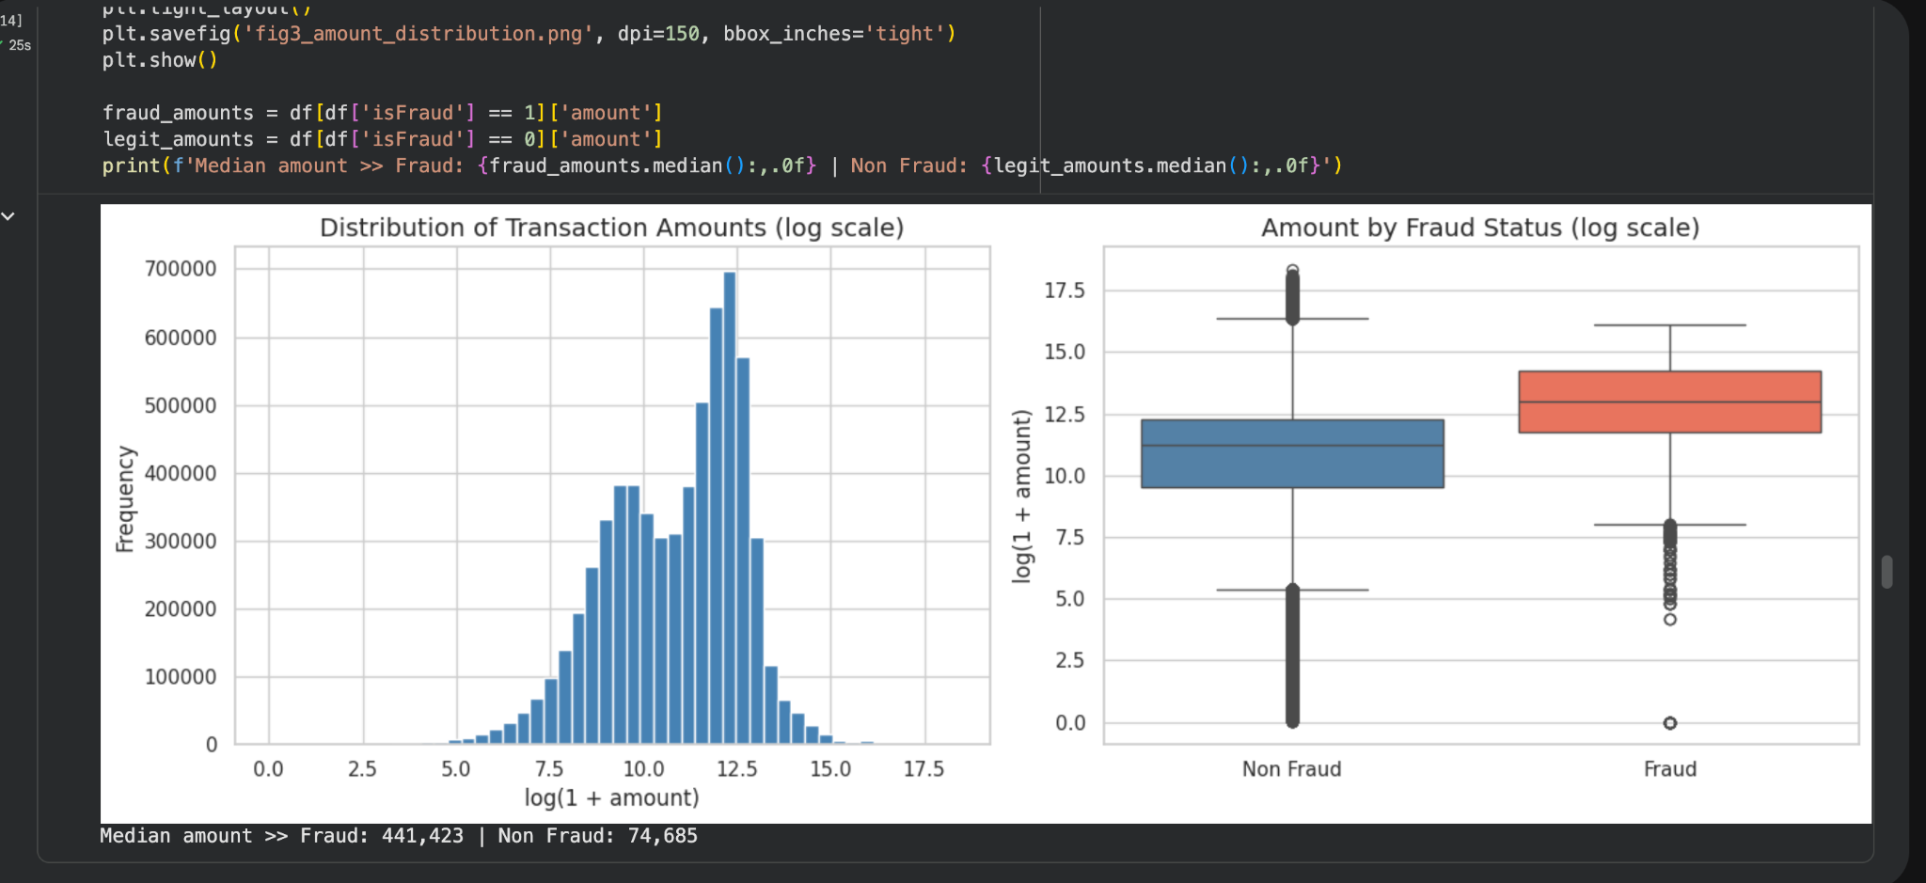
What patterns distinguish fraudulent transactions?
EDA Findings:
Fraud transactions have significantly higher amounts
Median fraud amount ≈ 441,423 vs non-fraud ≈ 74,685
Clear separation in distribution between fraud and legitimate transactions
Graph Insight:
Left plot shows overall distribution of transaction amounts (log scale)
Right plot compares fraud vs non-fraud using a boxplot
Fraud distribution is shifted higher, indicating larger transaction values

Slide 8
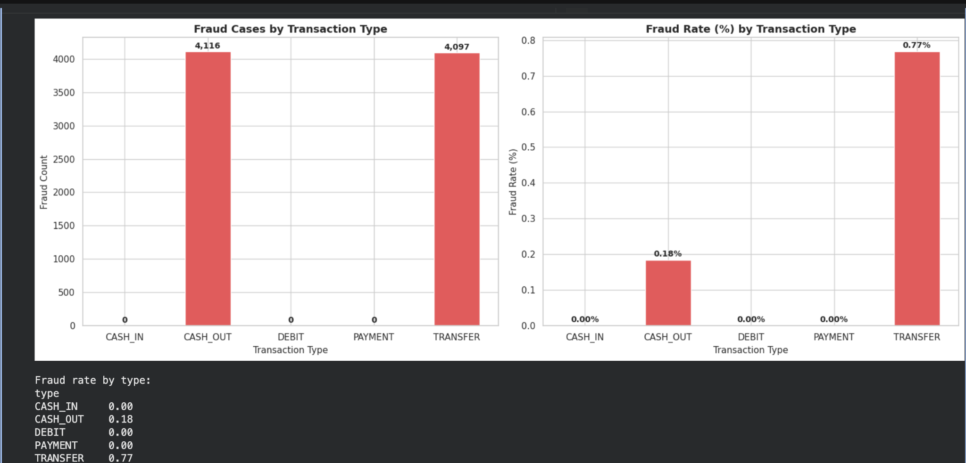
Which transaction types are most associated with fraud?
EDA Findings:
Fraud occurs only in:
TRANSFER
CASH_OUT
TRANSFER has the highest fraud rate (~0.77%)
CASH_OUT has lower fraud rate (~0.18%)
Graph Insight:
Left chart shows total fraud cases by type
Right chart shows fraud rate% relative to total transactions
Although counts are similar, TRANSFER is riskier when normalized

Slide 9
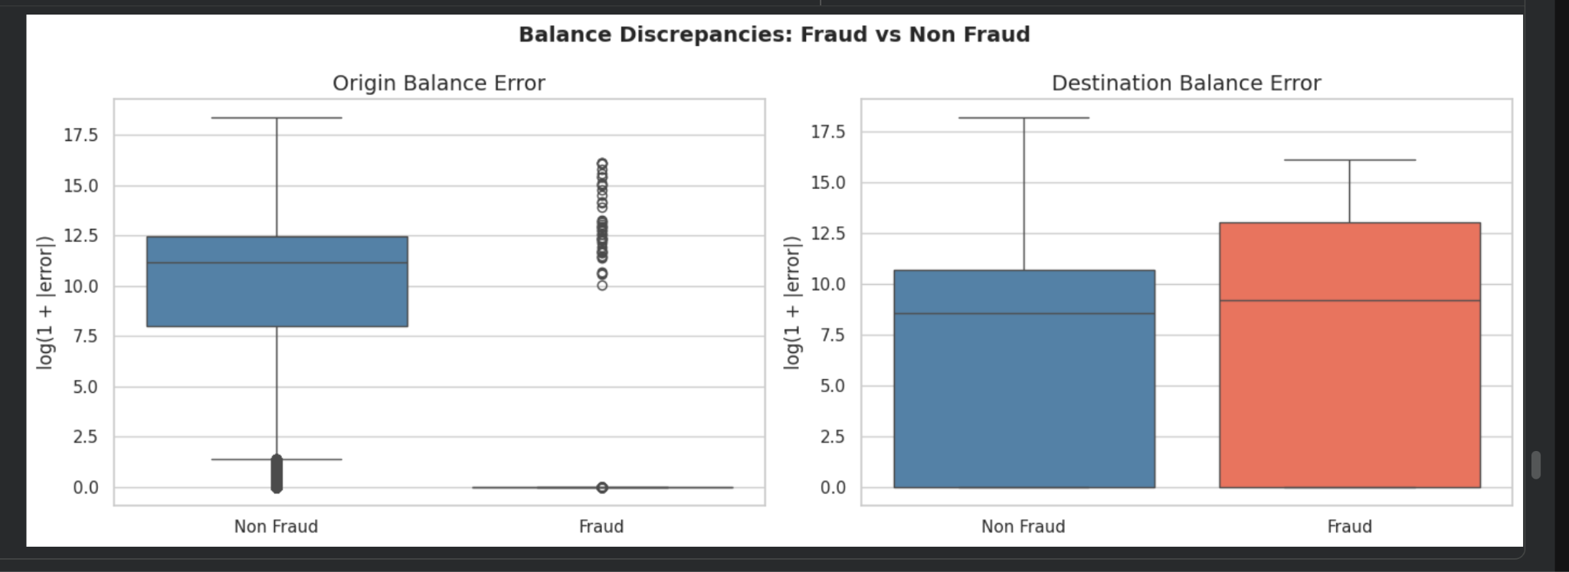
Do balance discrepancies indicate fraudulent activity?
EDA Findings:
Fraud transactions show significant balance discrepancies
Errors observed in both:
Origin balance
Destination balance
Graph Insight:
Left plot shows origin balance error
Fraud transactions exhibit distinct patterns (many values near zero)
Right plot shows destination balance error
Fraud transactions have higher variability and larger discrepancies
Clear difference b/w fraud and non-fraud distributions

Slide 10
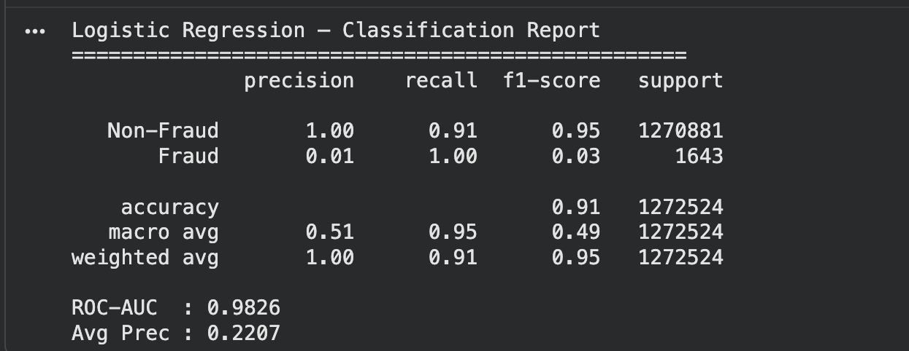
Can we build an accurate ML model for fraud detection?
Model Used: Logistic Regression
Method: Classification_Report
Trained a Logistic Regression model after preparing data:
Selected features:
-Transaction Type
-Amount
-Balance Variable
Target variable: isFraud (0/1)
Split the data into test and train sets and used a classification_report.
Results were:
Model achieves high accuracy (91%) due to class imbalance
Detects all fraud cases (Recall = 100%)
However, very low precision (1%) indicates many false positives
F1-score for fraud is low, showing imbalance in performance

Slide 11
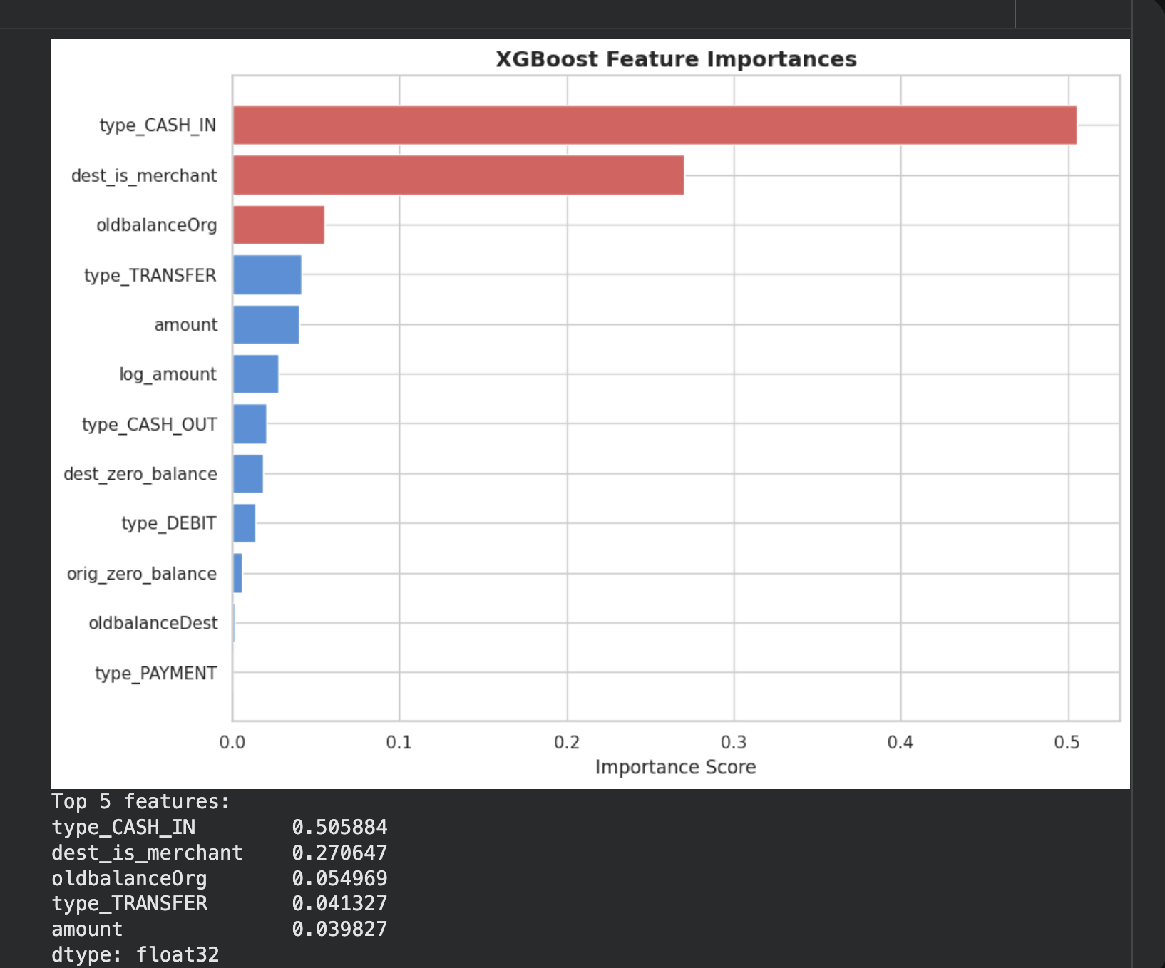
What features contribute most to fraud detection?
Model Used:
XGBoost
Method:
trained an XGBoost model on our dataset, then extracted feature importance scores from the trained model, which show how much each variable contributes to predicting fraud. These scores were then visualized in the graph.
Technical Insight:
Model relies heavily on transaction type encoding
Merchant indicator variable is a strong predictor
Balance-based features capture transaction consistency
Lower importance for type_PAYMENT and type_DEBIT
Interpretation:
Transaction type is strongest factor in predicting fraud
Merchant transactions are highly influential (engineered feature)

Slide 12
Conclusion
Key Findings:
Fraud is concentrated in specific transaction types (TRANSFER, CASH_OUT)
Fraudulent transactions involve higher amounts
Fraud violates expected balance consistency patterns
Machine Learning Insights:
Models can effectively detect fraud patterns
High recall ensures fraud cases are identified
Feature importance confirms:
Transaction type
Merchant behavior
Balance variables are critical
Fraud detection can be effectively achieved using a combination of transaction behavior, amount, and balance, with machine learning models using these features to make accurate predictions. The analysis can be used to make the transaction systems more secure by realising the loopholes fraudsters use and where do they use them (i.e specific transaction types, amounts etc)

